Slide 1
An evolution of Muslim Nationalism in British India
Partition of Bengal 1905
Hindus Reaction towards the partition of Bengal
Simla Deputation 1906
Formation of All India Muslim League 1906
Minto-Morley Reforms 1909
Annulment of Partition of Bengal

Slide 2
Partition of Bengal
When British occupied India Bengal was the largest province of sub-continent. With a population of approximately 78 million
The whole province was one administrative unit under single Lt. Governor. It was impossible for him to look after the whole of the province whenever required. The eastern part of Bengal remained neglected due to the vastness of the region.
It was decided that the Bengal should be partitioned into two provinces for the smooth administration of the region.
In 1899, Lord Curzon became the viceroy of India.
Lord Curzon realized the problem and prepared a partition plan of the province. In 1905, he sent the partition plan to England for its approval

Slide 3
The British government approved the partition plan, and Bengal was divided into eastern and western part. The new province of Bengal consisted of Dacca (capital city), Memensingh, and Assam. Rajshahi, Rangpur, Khulna, and Bogra as the constituent districts.
The Muslims became a majority in the newly created province of Eastern Bengal. The Muslims were 18 million out of 31 million in the new province.
Now the creation of new province where Muslims where in majority created opportunities for the Muslims.

Slide 4
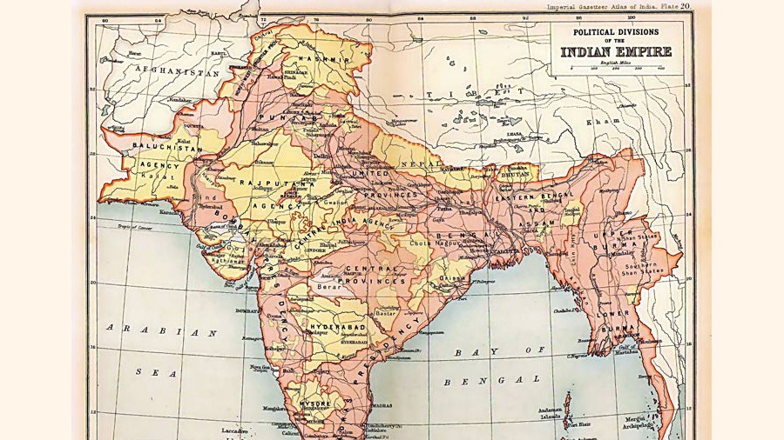

Slide 5
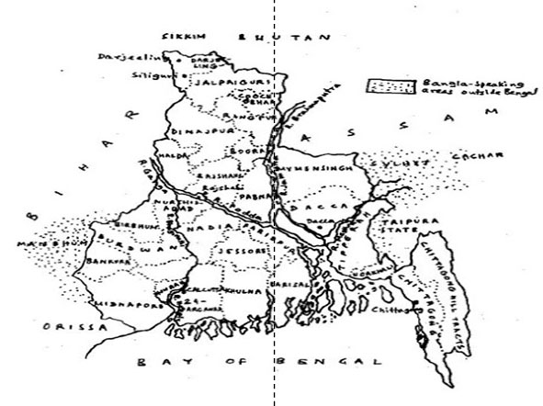

Slide 6
Hindu reaction toward the partition of Bengal
Hindus have turned into a minority in the new province of Eastern Bengal, they feared the Muslim domination on them.
The provincial high court was to be shifted to Dacca; the Hindu lawyers feared that their legal practice would be affected.
As the Dacca was to become the new center of journalistic and academic activities. The Muslim point of view would be given consideration in the newspaper.
The income of the Hindus would be affected. The exploitation of the poor Muslims by the rich Hindu landlords, capitalists, and traders would be finished.

Slide 7
Indian National Congress was established in 1885. It had announced that the political party would represent the interests of all the communities of India.
However, when the movement were launched by the Hindus against the partition of Bengal, and strikes were held throughout the country, The Congress actively participated in it.
The opposition of Hindus became violent when the people started refusing to pay taxes to the British government.
Swadeshi movement was started in which the British products were boycotted by the people. The train which was carrying the Governor of Eastern Bengal was derailed by Hindus to kill him.

Slide 8
Simla Deputation 1906
. The Hindus were opposed to Urdu and the partition of Bengal. The British government had also favored Hindus by replacing Urdu by Hindi.
The Muslims realized that they also need to organize themselves in order to safeguard the interests of the Muslims.
The principal of Aligarh College, Mr. Archbold assisted the Muslims leaders to get an appointment from the Viceroy.
Hence, a delegation of 35 Muslims leaders went to meet the Viceroy. The Muslims asked the Viceroy that adequate protection for the Muslims must be considered while introducing constitutional reforms in India.
The Muslim deputation asked the Viceroy that separate electorate should be introduced through which the Muslims should elect their own representative for municipalities, rural councils, provincial and central councils.

Slide 9
The Viceroy Lord Minto appreciated the stance of the Muslims, and he agreed that the Muslims should have right to separate electorate. He assured the Muslims that he would give due consideration to the demand of the Muslims.
Formation of All India Muslim League 1906
The anti-Muslim stance of the Congress following the partition of Bengal proved that Congress was not going to safeguard the interests of the Muslims. The Muslim leaders consulted each other for forming a political organization
The annual session of All India Muslim educational conference was held in Dacca in 1906. When the meeting was finished Nawab Salimullah convened a meeting of the Muslim leaders at his residents. The meeting was presided over by Nawab Viqar-ul-Mulk on 30th December 1906.
Nawab Viqar-ul-Mulk had emphasized the need of having a political association of the Muslims because Congress had not catered the needs of the Muslims.

Slide 10
The Muslim leaders thought that the Muslims are one-fourth of the population in India, and if the British left India the Hindus would dominate them politically due which they needed a political organization.
Hence a resolution was forwarded by Nawab Salimullah for the creation of All India Muslim League. The Muslim leaders attending the meeting approved the resolution
Objectives of the Muslim League
To promote loyalty among the Muslims for the British, and remove any misconception related to British government among the Muslims.
To protect the political rights and interests of the Muslims and to represent the Muslim interest to the British government.
To prevent the origination of any hostility among the Muslims towards any community of sub-continent.

Slide 11
The regular annual session of the All India Muslim League was held at Karachi on December 1907. The session was presided over by a prominent Muslim leader from Bombay Sir Adamjee Pirbhai presided over the session.
The draft constitution which was prepared by the appointed committee was discussed in the meeting. The constitution of the Muslim League was finally approved.
After the Karachi session of the Muslim League the next session was held at Aligarh in 1908. Justice Shah Din presided over the meeting. Sir Agha khan, who led the Simla deputation was elected as the President of Muslim League.
It was decided in the meeting that the branches of the Muslim League would be opened in other parts of the country.

Slide 12
Minto-Morley reforms of 1909
The British government wanted to introduce constitutional reforms in India. The Simla deputation had already asked for the right of separate electorate.
The Viceroy of India Lord Minto and The secretary of state Lord Morley worked together to prepare a draft bill to introduce constitutional reforms in India.
The constitutional reforms were introduced were named after the Viceroy and the secretary of state, which was known as Minto-Morley reforms of 1909.
Main points
The right to separate electorate was given to the Muslims.
The preparation of separate electoral rolls were initiated.

Slide 13
Annulment of Partition of Bengal
The opposition of the Hindus increased up to the level that the British government was compelled to reverse the partition plan.
The Hindus threatened the British government that they would boycott the visit of the King George to India. The threat worked and the British government agreed to annul the partition plan.
On 12th of October 1911, when King George was on the tour of India, he announced the annulment of the partition plan.

